Slide 1

Great Feedback:
Two Truths, Not One
Liane Davey, Ph.D.
3COze Inc.

Slide 2
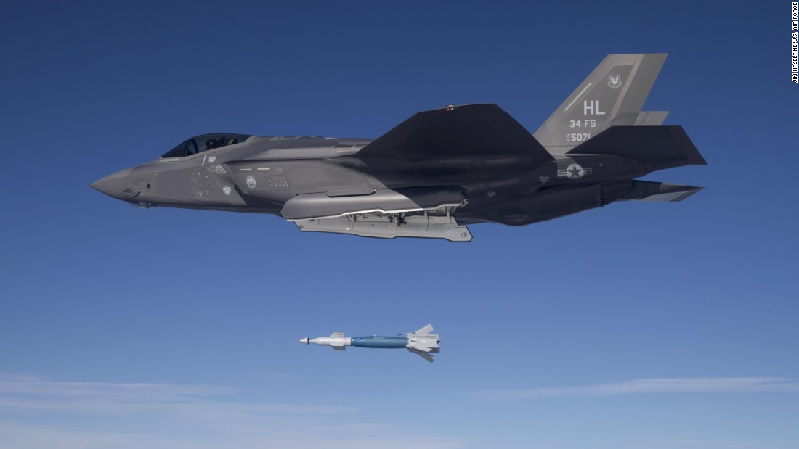

Most People Deliver Feedback Like Dropping a Bomb
When you deliver feedback this way,
  You stay at a high enough altitude to stay safe and therefore don't make a strong connection
  If you deliver a sneak attack, you present yourself as an adversary, triggering a defensive response
  If you keep moving after you deliver your payload, you don't know if the message hit the target

Slide 3

FEEDBACK
Definition
Orientation
Mindset
Formula
Habit

Slide 4


DEFINITION OF FEEDBACK
Information about reactions to a product, a person's performance of a task, etc. which is used as a basis for improvement.

Slide 5

Orientation
Feedback is about you
It should not include anything about the recipient that they didn't already know. Nor should there be any assumptions about what they think, what they feel, or who they are.

Slide 6

"Feedback is your truth, not the truth."

Slide 7

FEEEBACK IS AN OBLIGATION
It's a part of being a good team member
THERE'S NO "NEGATIVE" FEEDBACK
Only feedback intended to change a behavior
FEEDBACK IS NOT EVALUATION
Doesn't deserve evaluation's bad reputation
FEEDBACK BUILDS TRUST
It doesn't erode trust to be vulnerable
Mindset

Slide 8




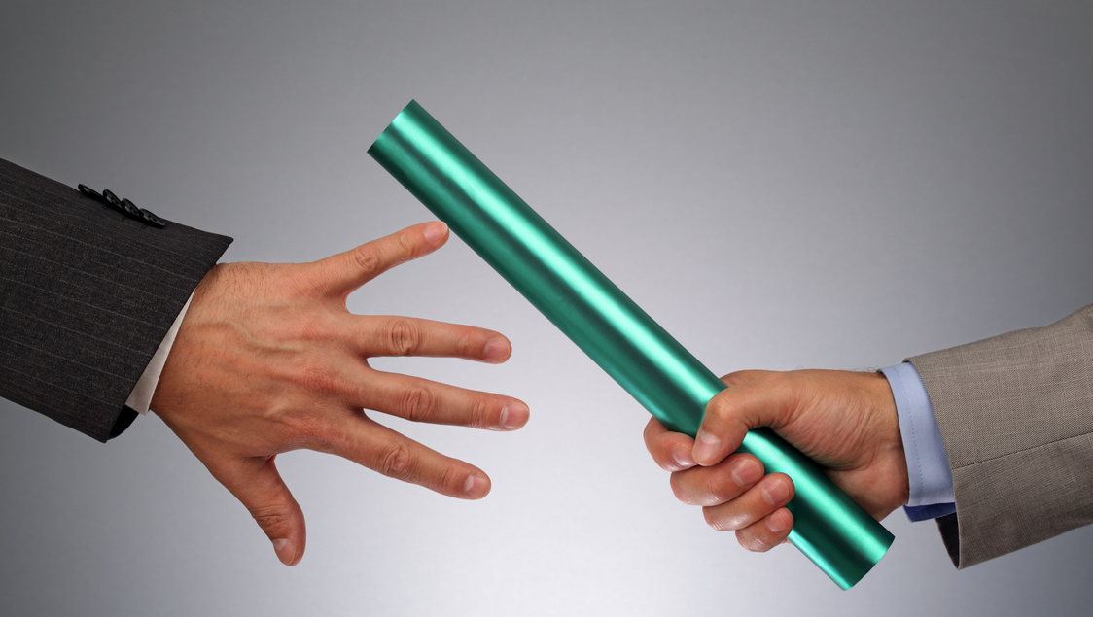
Formula
Delivering feedback well increases its value and reduces defensive reactions.
orient
translate
expose
invite
to the situation
you're thinking of
from judgment
to behavior
your reactions
and perceptions
the person
to share

Slide 9


INCREASE THE FREQUENCY
Feedback should be like flossing
DECREASE THE IMPACT
Use a casual tone to make it more comfortable
CELEBRATE USEFUL FEEDBACK
Share and solicit examples of good feedback
FRAME FEEDBACK AROUND TRUST
Use language that encourages candor
Habit

Slide 10

Receiving Feedback
FOCUS ON YOUR PRIORITY
Always have one style/leadership goal
SOLICIT FEEDBACK ON THAT
Ask for colleagues to watch for examples
REPORT BACK
Follow-up about how you’ll use the feedback
GIVE FEEDBACK ABOUT FEEDBACK
Share how their feedback affected you

Slide 11

QUESTIONS?
Reach out if you’d like to work through an example
liane.davey@3coze.com, craig.easdon@3coze.com

