Slide 1
Better Together Apart
Helping Remote and Hybrid Teams Thrive
🧰 📖 🎥 https://www.lianedavey.com/mackay/

Slide 2
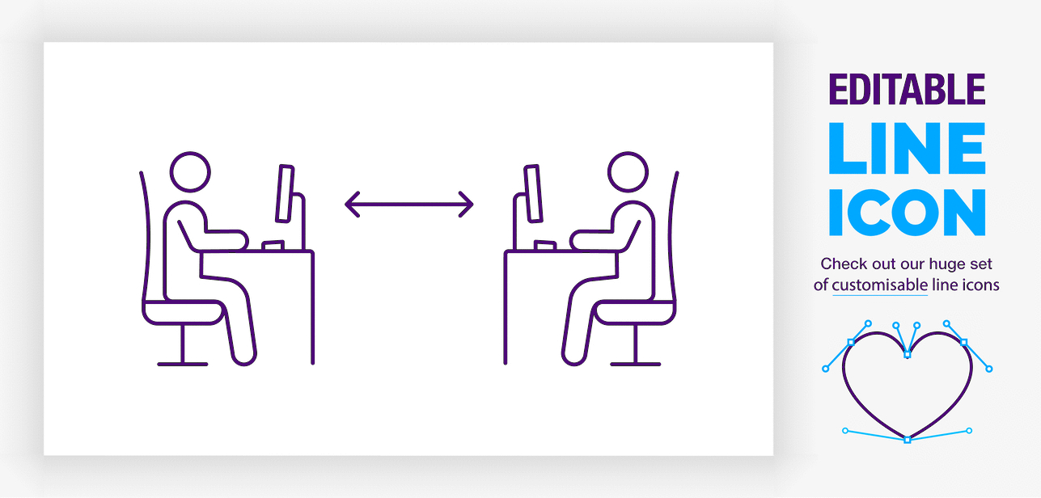


Definitions
Office Work
Work that is completed at a shared primary workplace.
Remote Work
Work that is completed at a location other than the primary workplace.
Virtual Team
Team that has no members physically together.
Hybrid Team
Team that has some members together and others working remotely.
Notes:
Interestingly, 90 feet is all it takes to effectively be a remote worker

Slide 3
Advantages of Each Work Style
Benefits of Remote Work
Enhanced productivity and quality
Increased engagement and reduced absenteeism
Reduced costs and environmental impact
Greater flexibility and reduced lost-time
Access to the best talent regardless of location
Better disaster preparedness
Benefits of Office Work
Informal interactions
Access to equipment for productivity
Reduced distractions and interference from personal life
Opportunity to play and celebrate
Unintentional interactions
Choudhury, P., Larson, B.Z., and Foroughi, C. (2019). Is it time to let employees work from anywhere? Harvard Business Review. https://hbr.org/2019/08/is-it-time-to-let-employees-work-from-anywhere

Slide 4
Challenges of Hybrid Teams
Trust is harder to build (and easier to destroy) virtually
Lack of context leads to unflattering judgments
Work is invisible and unseen work can lead to resentment
Virtual teams use written communication more, which leads to negativity bias
Absence of subtle cues prolongs conflict
Social friction reduces people’s willingness to ask for help when they need it
Communication discrepancies create diverging paths

Slide 5
Trust
Trust is harder to build (and easier to destroy) virtually

Slide 6

Building Trust
Trust, the willingness to be vulnerable, is important to the effectiveness of all teams
Teams with higher levels of trust are more productive, proactive, output focused
The link between trust and performance is because of increase risk-taking
  Asking for help
  Sharing and asking for feedback
  Discussing conflicts and mistakes openly
  Abandoning need to control others
The relationship between trust and performance is stronger in virtual/hybrid teams
Notes:
Good documentation reduces the dependence on trust

Slide 7
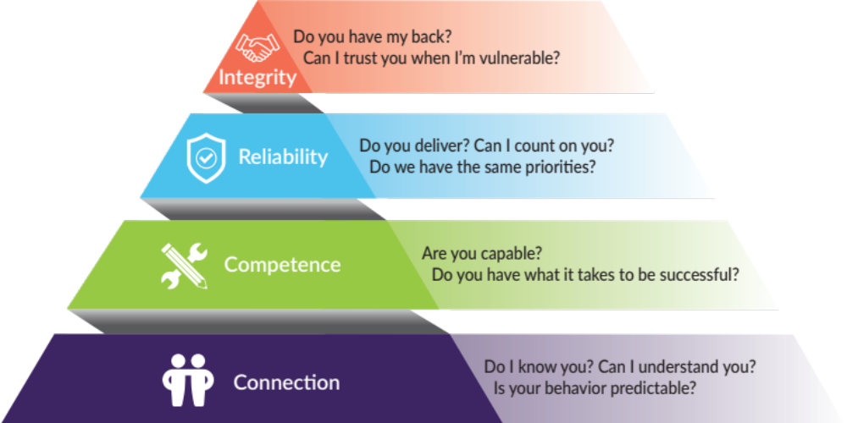
Dimensions of Trust 📖

Slide 8
Establish a line of communication early.
Don’t wait until you’re thirsty to dig a well.

Slide 9
Context
Lack of context leads to unflattering judgments

Slide 10



Mutual Knowledge 🧰
Mutual knowledge is the knowledge team members share, both content and context
Having mutual knowledge is more difficult in virtual/hybrid teams because:
  Failure to share or remember contextual information
  Uneven distribution of information
  Differences in what is salient to the sender and receiver
In the absence of shared content or context:
  Problems are attributed to skills or character
  Individuals fail to meet one another’s expectations
  Trust erodes and performance suffers

Slide 11
Unseen Work
Work is invisible and unseen work can lead to resentment

Slide 12
Unseen Work 🧰
Unseen work is the effort (physical, cognitive, and emotional) that is required to complete one’s job, but is not visible to others
Unseen work creates resentment
Address it before it becomes toxic to your team
  Document tasks where the effort is out of line with the output (especially if it’s emotionally taxing because it’s aversive, or unfair, or exhausting)
  Ask teammates whether they are feeling similarly and compare notes
  If possible, find more efficient or effective ways to address low value tasks
  If work must continue, acknowledge the effort

Slide 13
Negativity Bias
Written communication is susceptible to negativity bias

Slide 14
Information Richness 📖
Information richness is "the ability of information to change understanding within a time interval.” Daft & Lengel
Based on the capacity of the medium to transfer cues that help the receiver interpret meaning (gestures, pitch and tone, facial expressions, body language)
Use rich media for
  novel, complex content
  Participants with little shared knowledge, experience, or language
  Discussions with tension or conflict
Use lean media for routine issues or with people you know well

Slide 15
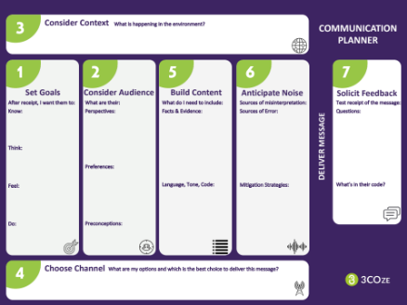
Clarifying Intentions 🧰
Lean communication media leave more room for misinterpretation
Make intentions explicit
  Focus: What is the most important part of the message?
  Tone: How do you want the receiver to feel?
Asynchronous communication makes negativity more likely
  Senders are less guarded and more negative in writing
  Receivers interpret communications more negatively than intended

Slide 16

Negativity Bias
When writing, the sender tends to be more direct and edgy than when speaking
When receiving, we interpret written messages more negatively
People believe 90% of receivers will understand their messages
The data suggest it’s only about 50% who receive the message as intended
The less context and content, the more room for negativity bias
“Nice job” or “Great work” is interpreted as sarcastic 60% of the time
Remove squishy,
sneaky adjectives!
Morgan, N. (2018). Can You Hear Me? How to Connect with People in a Virtual World. Harvard Business School Press.

Slide 17
New Research-based Practices 📖
Increase use of audio plus content (screen sharing with no video)
  Equality of speaking, a predictor of collective intelligence, goes up on audio calls
Increase use of phone calls
  Empathetic understanding is higher on phone calls
Increase use of communication bursts (shared independent work time)
  Communication bursts create a collaborative experience across virtual teams
Riedl, C. and Williams Woolley, A. (2020). Successful Remote Teams Communicate in Bursts. Harvard Business Review. https://hbr.org/2020/10/successful-remote-teams-communicate-in-bursts

Slide 18
Prolonged Conflict
Absence of subtle cues prolongs conflict

Slide 19






Working Through Conflict 🎥
Conflict can be more challenging when you don’t interact with your colleagues in person
  Fewer casual interactions to build trust
  Interactions are forced to leaner modes, prone to misinterpretation
  Easier to avoid conflict
  Conflict can be magnified over time
The best answer is to deal with conflict early
Before it grows, creates mistrust and affects
other interactions

Slide 20


Exercise: I Love/I Wish
What do you love about
working hybrid/remotely?
What do you wish we
could make happen?

Slide 21
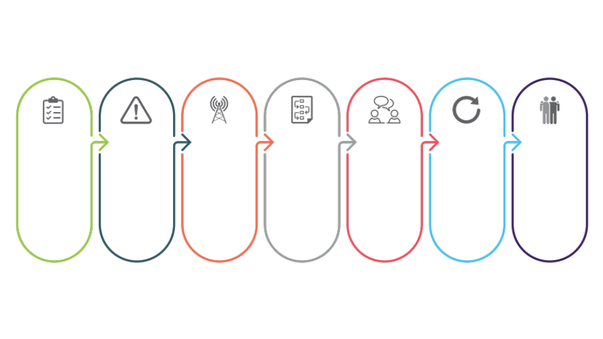
Steps for Remote Conflict 🎥
PREPARATION
HEADS UP
CHANNEL
CHEAT SHEET
FEEDBACK
FOLLOW UP
RECONNECT
Prepare your thoughts and collect objective examples to illustrate your point.
Let the person know you’d like to speak about a concern and specify the issue so they can prepare.
Choose a rich communication channel that will allow you to display a constructive tone.
Prepare a few notes for yourself with the right wording and any reminders to help you stay calm.
Deliver your feedback, share the impact, and ask a question to begin the two-way dialogue.
Reach out after a day or two. See how the feedback landed and take appropriate steps until resolved.
Reconnect with your colleague on a lighter note to show that the concern is in the past.

Slide 22
Social Friction
Social friction reduces willingness to ask for help

Slide 23
Increasing Capability and Confidence
In virtual/hybrid teams, knowledge and skill gaps persist because of:
  Social concerns (reluctance to approach unfamiliar coworkers, fear of showing incompetence)
  Coordination difficulties (setting up time together)
  Search challenges (knowing whom to ask)
Some employees avoid remote work for fear of missing out on social learning
Virtual knowledge sharing is an approach to overcome the social friction of asking for help
Sandvik, J. J., Saouma, R. E., Seegert, N. T., & Stanton, C. T. (2020). Workplace knowledge flows*. The Quarterly Journal of Economics, 135(3), 1635–1680. https://doi.org/10.1093/qje/qjaa013

Slide 24
Communication Discrepancies
Communication discrepancies create diverging paths

Slide 25
Disparate Communication
Managers who are in the office with some of their team are likely to communicate differently
  Office workers get more casual chatter, which is an advantage
  Office workers get the brunt of spontaneous tasks, which overwhelms them
  Remote workers miss opportunities and insights, which disadvantages them
Be very aware and deliberate about what you share and with whom
These discrepancies can lead to false perceptions of people and even to self-fulfilling prophecies that disadvantage remote team members

Slide 26


Off-task Time
Off-task time is critically important to foster trust and make space for informal conversation that supports cohesiveness, problem-solving, and innovation.
Meeting Time
  Take advantage of meeting time to build in space for off-task discussions
  Use a rolling start to your meetings and protect 5 minutes for casual chatter
  Encourage team members to leave their cameras on during breaks
  Protect 15-30 minutes of agenda-free time each week
Water Cooler Time
  Recreate the spontaneous conversations that normally happen around the water cooler
  Set a virtual office hour each week where team members can drop in on you
  Have a weekly coffee hour or shared lunch time
  Use Yammer and Teams to share photos, articles, and other appropriate non-work related items

Slide 27
Communication is, by definition, not something
you can accomplish on your own.
You can't communicate to someone; you can only communicate with them.

Slide 28
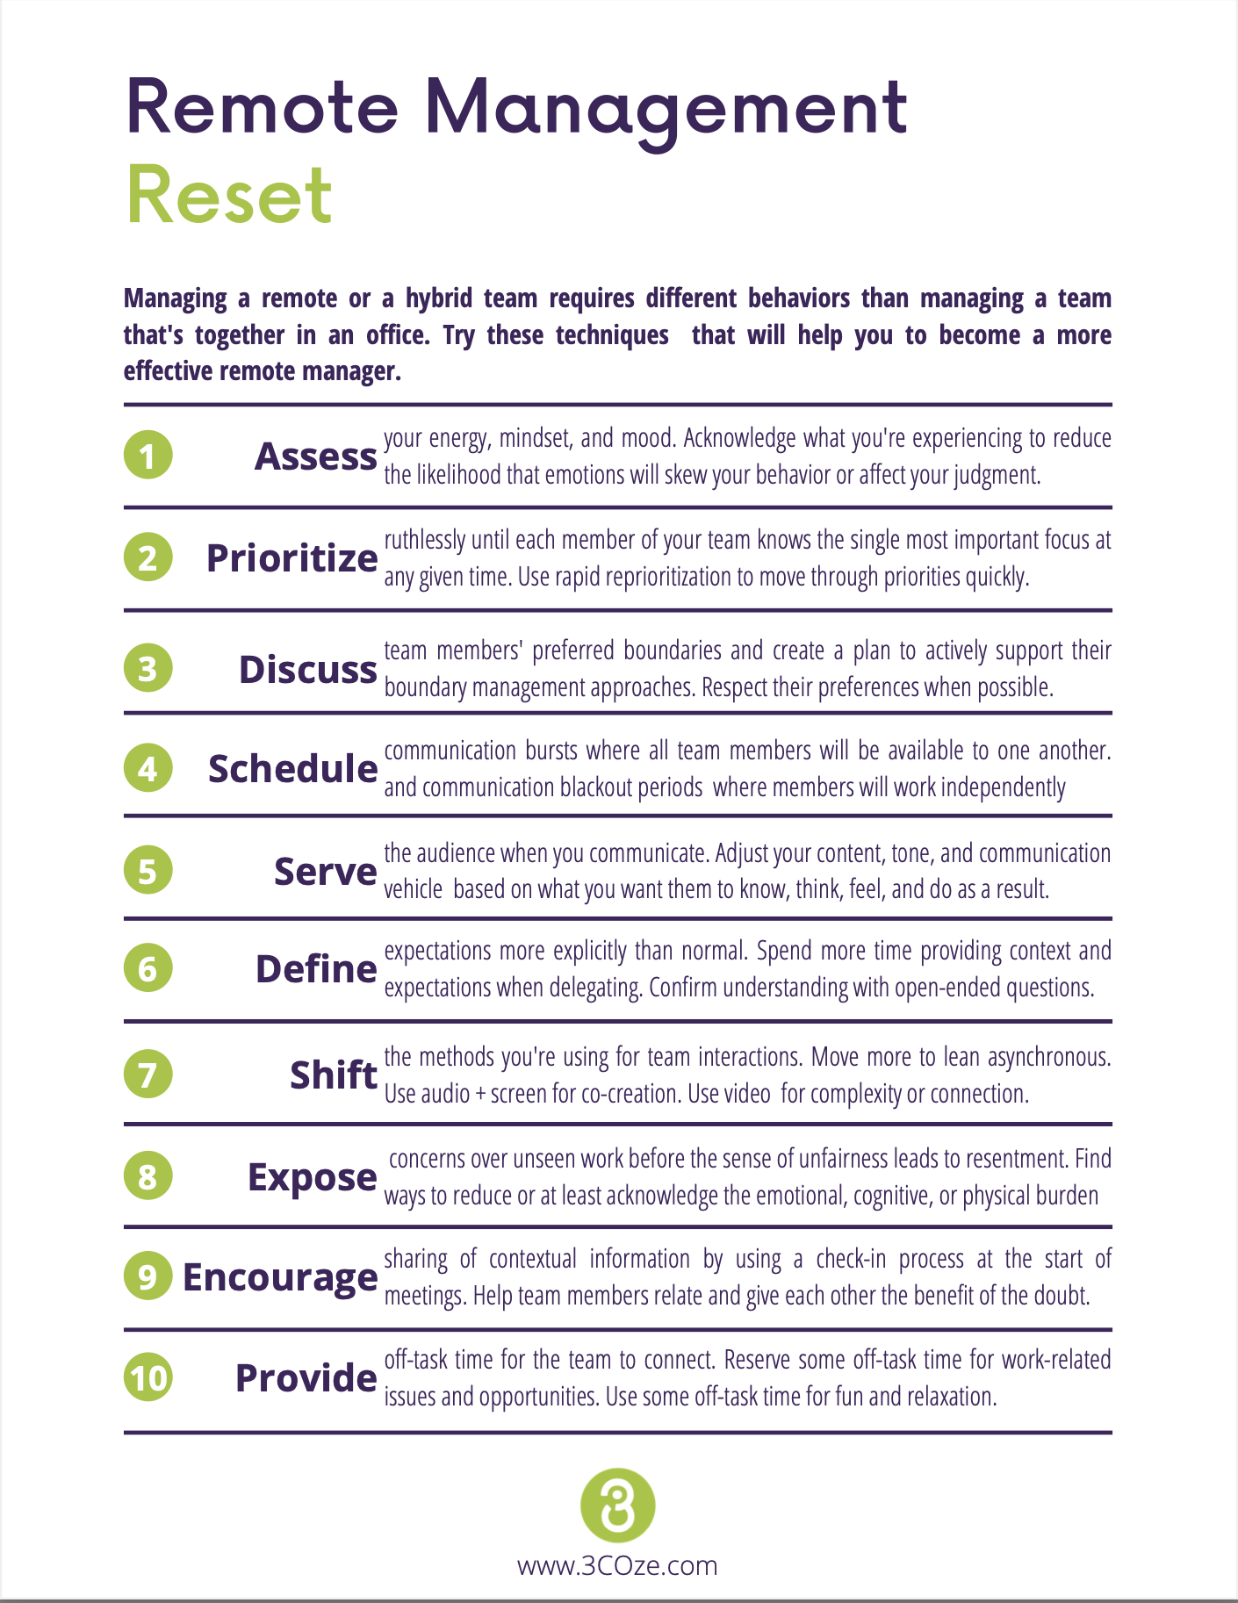
Remote Management Reset 🧰
These are the top 10 things you can do as a manager to reset to a more effective style of managing a remote or hybrid team

Slide 29
Thank You.
Please connect with me on LinkedIn
And find all the resources at https://www.lianedavey.com/mackay/

