Slide 1
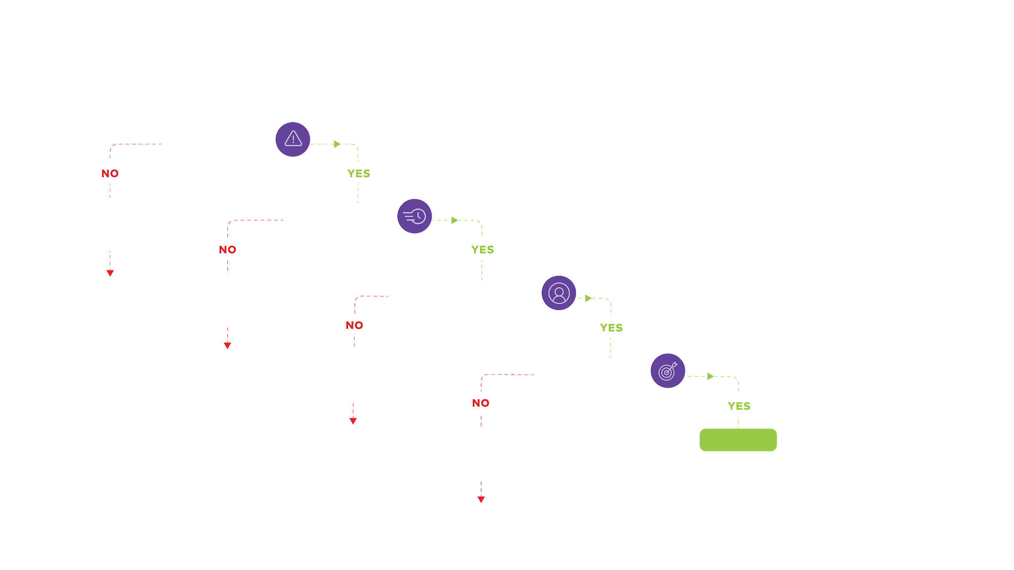

4D’s Decision Tree
Is it important?
Nothing necessary
will be compromised without this task
Is it urgent?
Delete
Nothing meangingful
will be compromised by deferring this task
Does it need to be you?
Delay
Nothing significant will be compromised if someone
else does the task
Is it essential?
Distribute
Nothing critical will be compromised by removing
parts of the task
GET ON IT!
Diminish

Slide 2
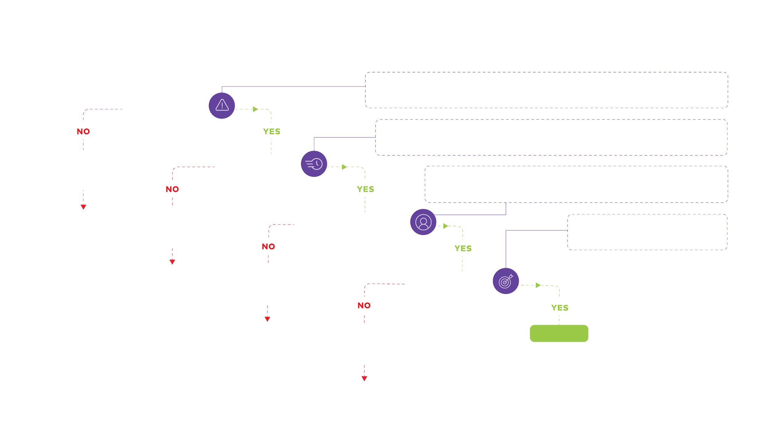
4D’s Decision Tree
How will the outputs be used?
Who are the beneficiaries of the work?
How will the work affect any decisions?
What are the stakes associated with the work?
Is it important?
  When are the outputs needed? By whom?
  What decisions are waiting this?
  Will I be more effective later?
  What are the impacts of postponement?
Nothing necessary
will be compromised without this task
Is it urgent?
  What skills are needed for success?
  Who can do this work efficiently?
  Would they notice if it wasn’t you?
  Who knows the stakeholders?
Delete
Nothing meangingful
will be compromised by deferring this task
Does it need to be you?
  What is core vs nice to have?
  How could this be done more easily?
Delay
Nothing significant will be compromised if someone
else does the task
Is it essential?
Distribute
Nothing critical will be compromised by removing
parts of the task
GET ON IT!
Diminish

